Slide 1
Modelling the Effect of Monetary and Fiscal Policy on Housing Price in Germany 2000-2020
Mohamadreza Sabaghian

Slide 2
Macroeconomics and Housing Market
Why to model ?
Psychological Importance for People(need for schelter)
Central Banks and Governments Policies
Data Based Planning and Prediction
Notes:
The need for a shelter is one of the most fundamental needs from Malsow‘s Pyramid
The psychological and economical impact of housing on people economy is undeniable
Therefor, housing sector is a major area of interest for both governments and people
Models are used to simulate the behavior of the real system for prediction and planning purposes.
5) This work examines the impact of monetary policy and a range of sector-specific and macroeconomic shocks on the German housing market

Slide 3
Macroeconomics and Housing Market
Approaches:
Analytical Transition Channels
Numerical Model Identification from Data
Notes:
In this work, we firstly examine an existing well known model in this area with the real data from German economy.
Secondly, identify a model from data to get a better understanding of the system.

Slide 4
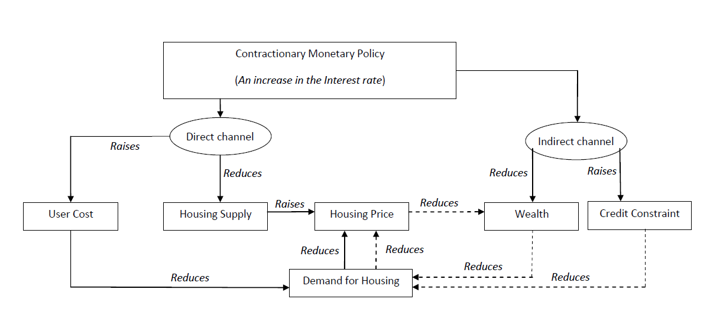
Transition Channels
Source: Wadud 2009
Notes:
Standard approach for macroeconomics is the IS-LM .
A two-dimensional macroeconomic tool that shows the relationship between interest rates and assets market (also known as real output in goods and services market plus money market).
2)Mishkin (1996) provides a comprehensive analytical framework on how the effects of
monetary policy are transmitted through various channels. Has ISLM model in its heart.
1) direct effects of monetary policy is transmitted on to the user cost on housing,
short-term rate, long-term rate also tends to rise driven by expectations of future
increase in the short-term rate; and hence, the average mortgage rate also raises leading to
higher user cost of capital on housing
defined as an opportunity cost of occupying a house rather than renting. If the opportunity
cost of owning a house is lower than renting, demand for housing activities is likely to
decline.
2) From the supply side perspective, any increase in short term interest rate may have an
immediate impact on housing construction cost, thereby housing output.
3) It is understandable that the fall in real house prices due to lower demand for housing as a
result of contractionary monetary policy will lead to a decline in asset (wealth) for
Individuals
4) Households might be credit constrained whose expenditure exceeds their revenue. reduces their cash. Th Higher nominal rates, , reduce current cash flow due to increase in mortgage rate will lower after interest and tax income.
From credit channel perspective,
5) due to asymmetric information between
potential house buyer and financial institution Lenders are reluctant to make
loans because they have difficulties identifying the credit worthiness of the borrower.

Slide 5
Macroeconomics Data
Interest Rate (r)
money market interest rate (EONIA)
ECB's deposit facility rate + ECB interest rates for main refinancing operation
Yearly Averaged
Source: Bundesbank Timeseries
Goverment Spending (rg)
General government deficit(+) or surplus(-) as defined in the Maastricht Treaty
Source: Bundesbank Timeseries
Yearly Change in Percentage
Notes:
r is the money market interest rate (EONIA) rate at which banks provide loans to each other with a duration of 1 day, In my opinion this is a good indicator of the monetary policy since it combines central banks ECB's deposit facility rate and s. This affect is more clear when we look in the recent data after 2018 where central banks interest rate for refinancing is zero but the deposit facility goes negative and this stimulates banks to lend more money. Original data is monthly and we need to average to get the yearly rate. See https://www.Bundesbank
Eonia is short for Euro OverNight Index Average. The Eonia rate is the 1-day interbank interest rate for the Euro zone. In other words, it is the rate at which banks provide loans to each other with a duration of 1 day..de/en/statistics/time-series-databases
2) General government deficit(-) or surplus(+) as defined in the Maastricht Treaty from Bundes Bank is used, In my opinion it is a good indicator of the Government fiscal policy since it includes both expenditure and earinging of the gorvernment. Change in percentage for each year is calculated and sign is reversed such that when the governemnt has a deficit it is an indicator if positive government spending.

Slide 6
Housing Market Data
Real House Price (hp)
Ratio of Nominal Price to the Consumers’ Expenditure Deflator
Source: OECD 2020
Normalized (2015 = 100)
Inflation and Seasonal changes into account
Material Cost (mc)
Percentage of Change Construction price index
Source: Bundesbank 2020
Notes:
1) The real house price is given by the ratio of nominal price to the consumers’ expenditure deflator in each country, both seasonally adjusted, from the OECD national accounts database.

Slide 7
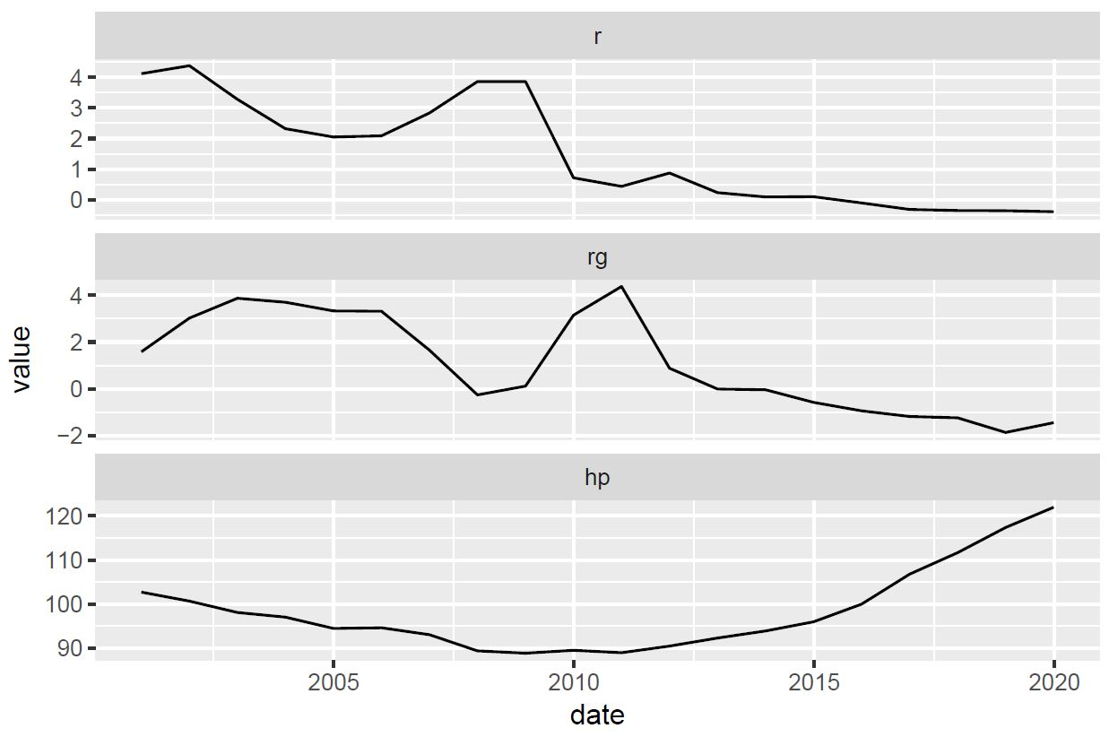
Transition Channels
Notes:
Very sticky price look at how when governmetn reduces spending house price increase! Memorize this!

Slide 8
Data
Housing Supply (h)
Number of Completed New Dwelling in West Germany in Thousand
Source: Statista 2020
Gross Domestic Product (ry)
Price Adjusted
Normalized (2015 = 100)
Source: Bundesbank 2020
Notes:
1) west germany is used as trend is the same in east! this is the only free source of data I could find for this period.
in thousenad number-completed-new-dwellings-west-germany/ in thousenad
2)

Slide 9
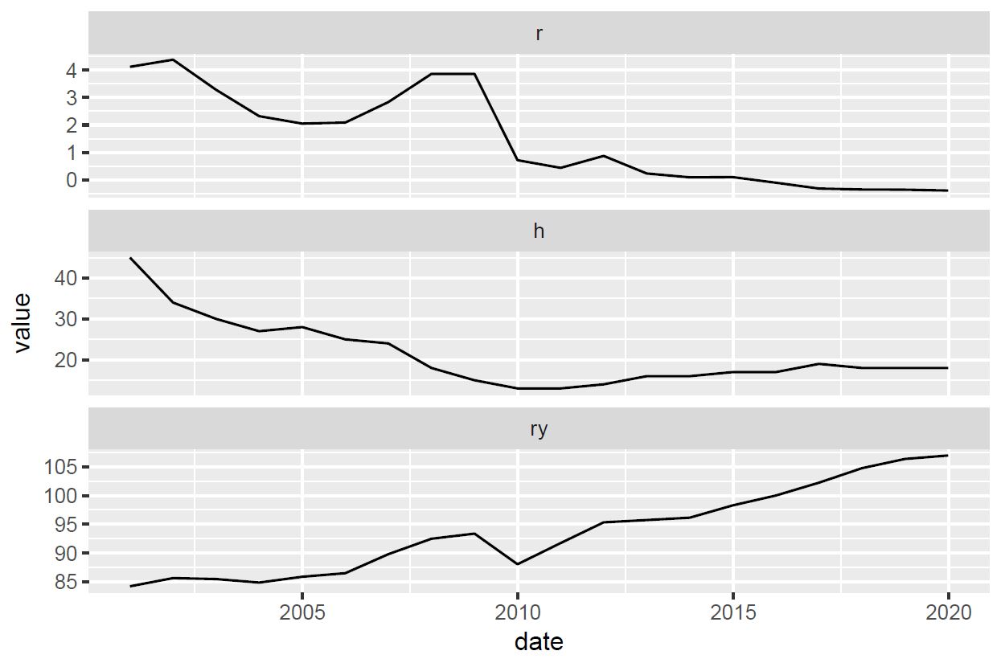
Transmission
Notes:
Decrease interest rate – increase in supply and output

Slide 10
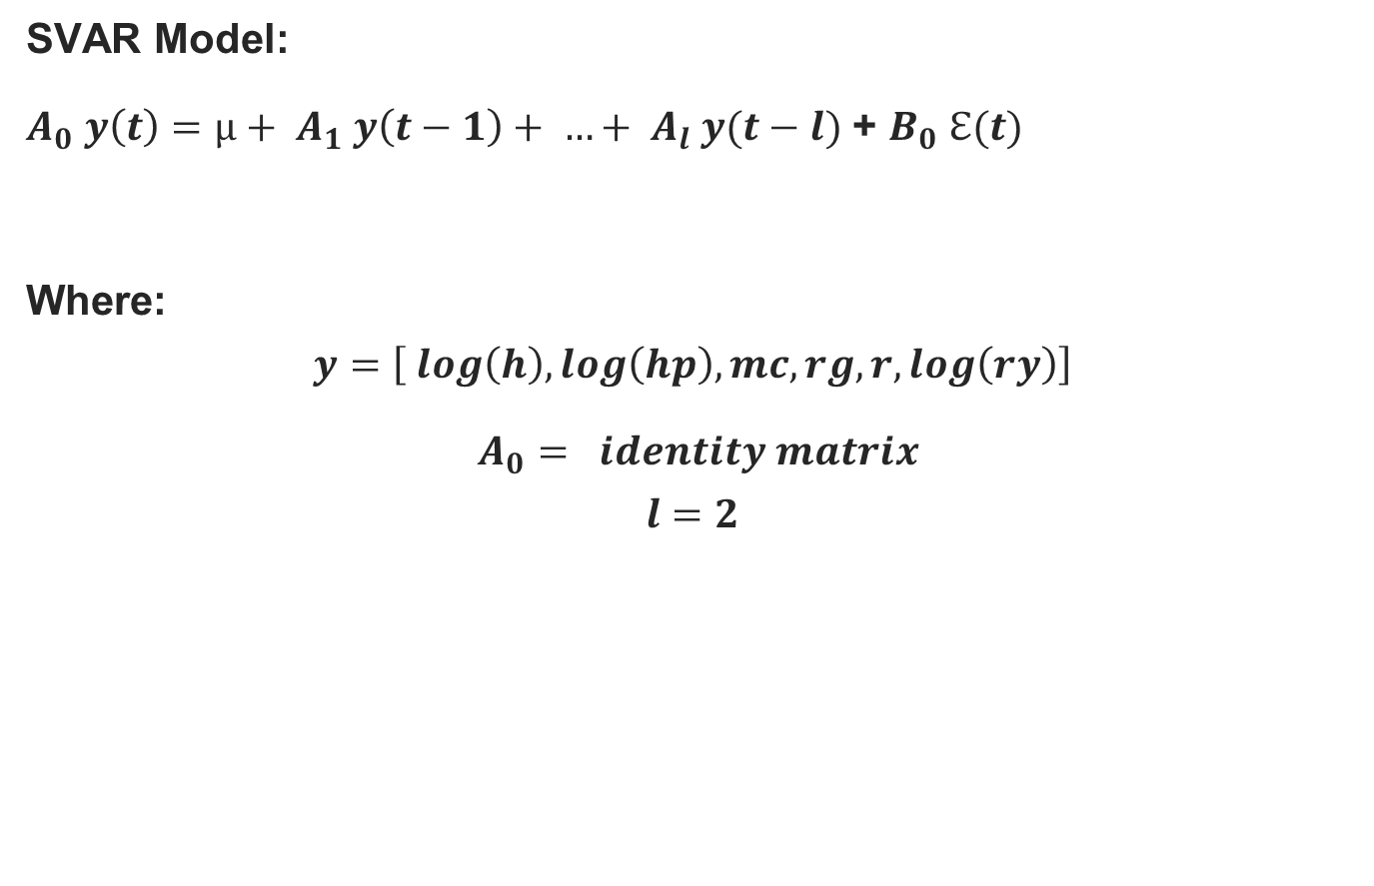
SVAR Identification
SVAR Model:
$A_{0} y\left(t\right)={µ+ A}_{1} y\left(t−1\right)+ …+ A_{l} y(t−l)$ + $B_{0} ℇ(t)$
Where:
$$y=\left[ log\left(h\right), log\left(hp\right), mc, rg, r, log\left(ry\right)\right]$$
$A_{0}= identity matrix$
$$l=2$$
Notes:
1) is a stochastic process model used to capture the linear interdependencies among multiple time series
The error terms$\epsilon_t$ (structural schocks) is an n-vector of serially uncorrelated zero mean structural schocks. matrix.
2) All variables in a VAR enter the model in the same way: each variable has an equation explaining its evolution based on its own lagged values, the lagged values of the other model variables, and an error term
3) The vector ut consists of reducedform residuals, which are serially uncorrelated with E(ut) = 0 and Cov(ut) = Σu. The nonsingular matrix B captures the instantaneous effects of the structural shocks εt = B−1ut on the variables of the system
The second challenge is that the number of parameters to be identified in the structural model is larger than that of the reduced VAR form. Therefore, some new relations needs to be introduced. This can be usually done by introducing restrictions on $A_0$ or $B_0$

Slide 11

Identification in R

Slide 12
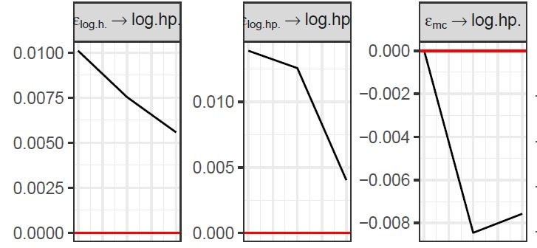
Impulse Response
Increase in supply reduces the price
Material Cost has very small effect
Notes:
Looking in material cost data it decreses 2011 to 2015 but house price increses sharply

Slide 13
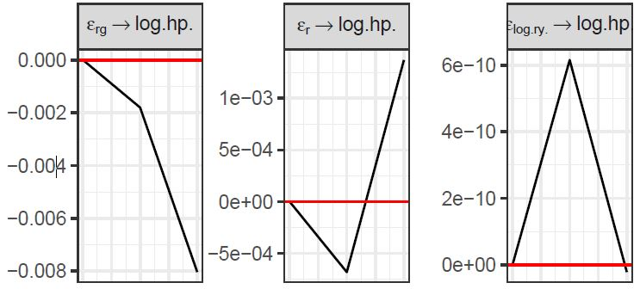
Impulse Response
Increase in governemnt spending reduces the price!
Interest rate increase reduces the price
Icrease in GDP increases the price
Notes:
Very sticky house price we identified only with 2 years!

Slide 14
Conclusion
Idnetified Model can help Governments, managers and individuals with planning
Microeconomics is not enough
Take risk of changes in macro economics into account when defining project goals
Different countires have different macroeconomics policies consider them before entering the market

Slide 15
Future Work
Model consists of the assumptions and data so choose wisely
Rich dataset (from nonkeynesian governments)
Data analysis before identification for lag and parameter selection
Constraints can be added!

Slide 16
References
Bundesbank (2020) doi: https://www.bundesbank.de/en/statistics/time-series-databases (Accessed on 18 May 2020)
OECD (2020), Housing prices (indicator). doi: 10.1787/63008438-en (Accessed on 18 May 2020)
Statista (2020) .doi: https://www.statista.com/statistics/999254/number-completed-new-dwellings-west-germany/ (Accessed on 18 May 2020)
Mishkin, Frederic S. (1996): The Channels of Monetary Transmission: Lessons for Monetary Policy, NBER Working Papers 5464, s.I.: National Bureau of Economic Research,
Mishkin, Frederic (2007): Housing and the Monetary Transmission Mechanism, in: Finance and Economics Discussion Series, 2007 (2007), pp. 1–53
Wadud, I.K.M., Bashar, Omar, ali ahmed huson joher, huson joher (2009): An SVAR Analysis of Monetary Policy Dynamics and Housing Market Responses in Australia, in:
Deakin University, Faculty of Business and Law, School of Accounting, Economics and Finance, Economics Series (2009)
Lange2020 Lange, Alexander, Dalheimer, Bernhard, Herwartz, Helmut, Maxand, Simone (forthcoming): svars: An R Package for Data-Driven Identification in Multivariate Time Series Analysis, in: Journal of Statistical Software (forthcoming)

